Slide 1
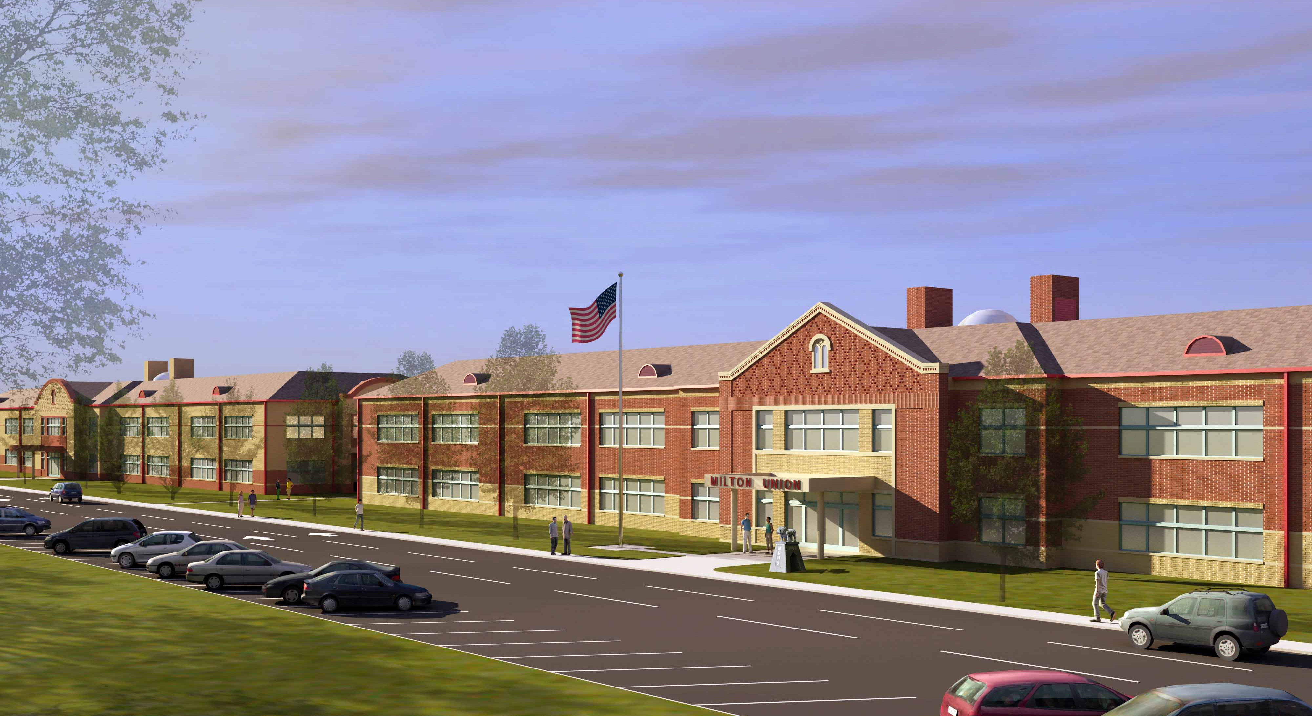

Milton Union Schools
Green Initiatives
Heapy Engineering
Rick Pavlak, PE, LEED AP BD+C

Slide 2
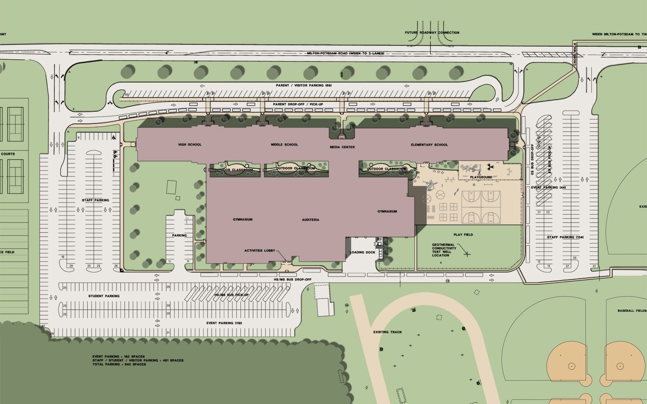
Chiller / Ice Storage
High Efficiency Chillers / Ice Storage
Size: 1900 Nominal, 1562 Actual Ton Hours
Cost: $165,000
Payback: 2.4 yrs

Slide 3
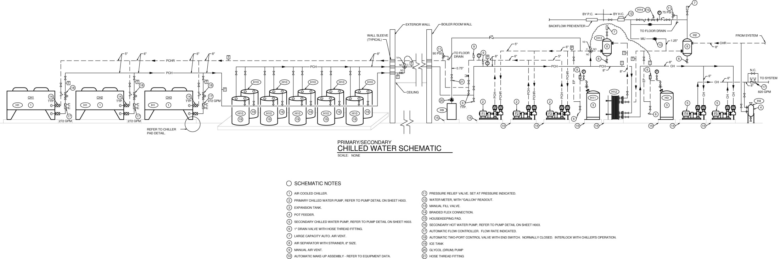
High Efficiency Chillers / Ice Storage

Slide 4
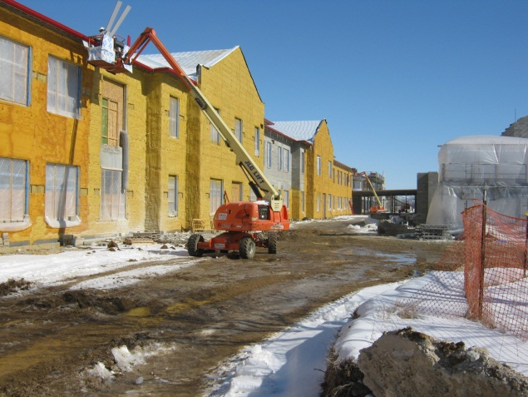
LED Site Lighting
LED lighting vs. metal halide
Installed Premium for LED:
31 Large x $1,800 + 28 Small x $750 (Est) = $76,800
Energy Savings for (using) LED:
31 Large x 137W (savings) + 28 small x 11W (savings) = 4.5kW
Yearly Savings for LED:
4.5kW x 12hrs/day x 365 days/yr x 8.5cents/kwH = $1,675/yr
Simple Payback (without maintenance):
$76,800 / $1,675 = 45.8 years
LED site lighting for pedestrian scale lighting only was pursued (parking lot is PSMH).

Slide 5
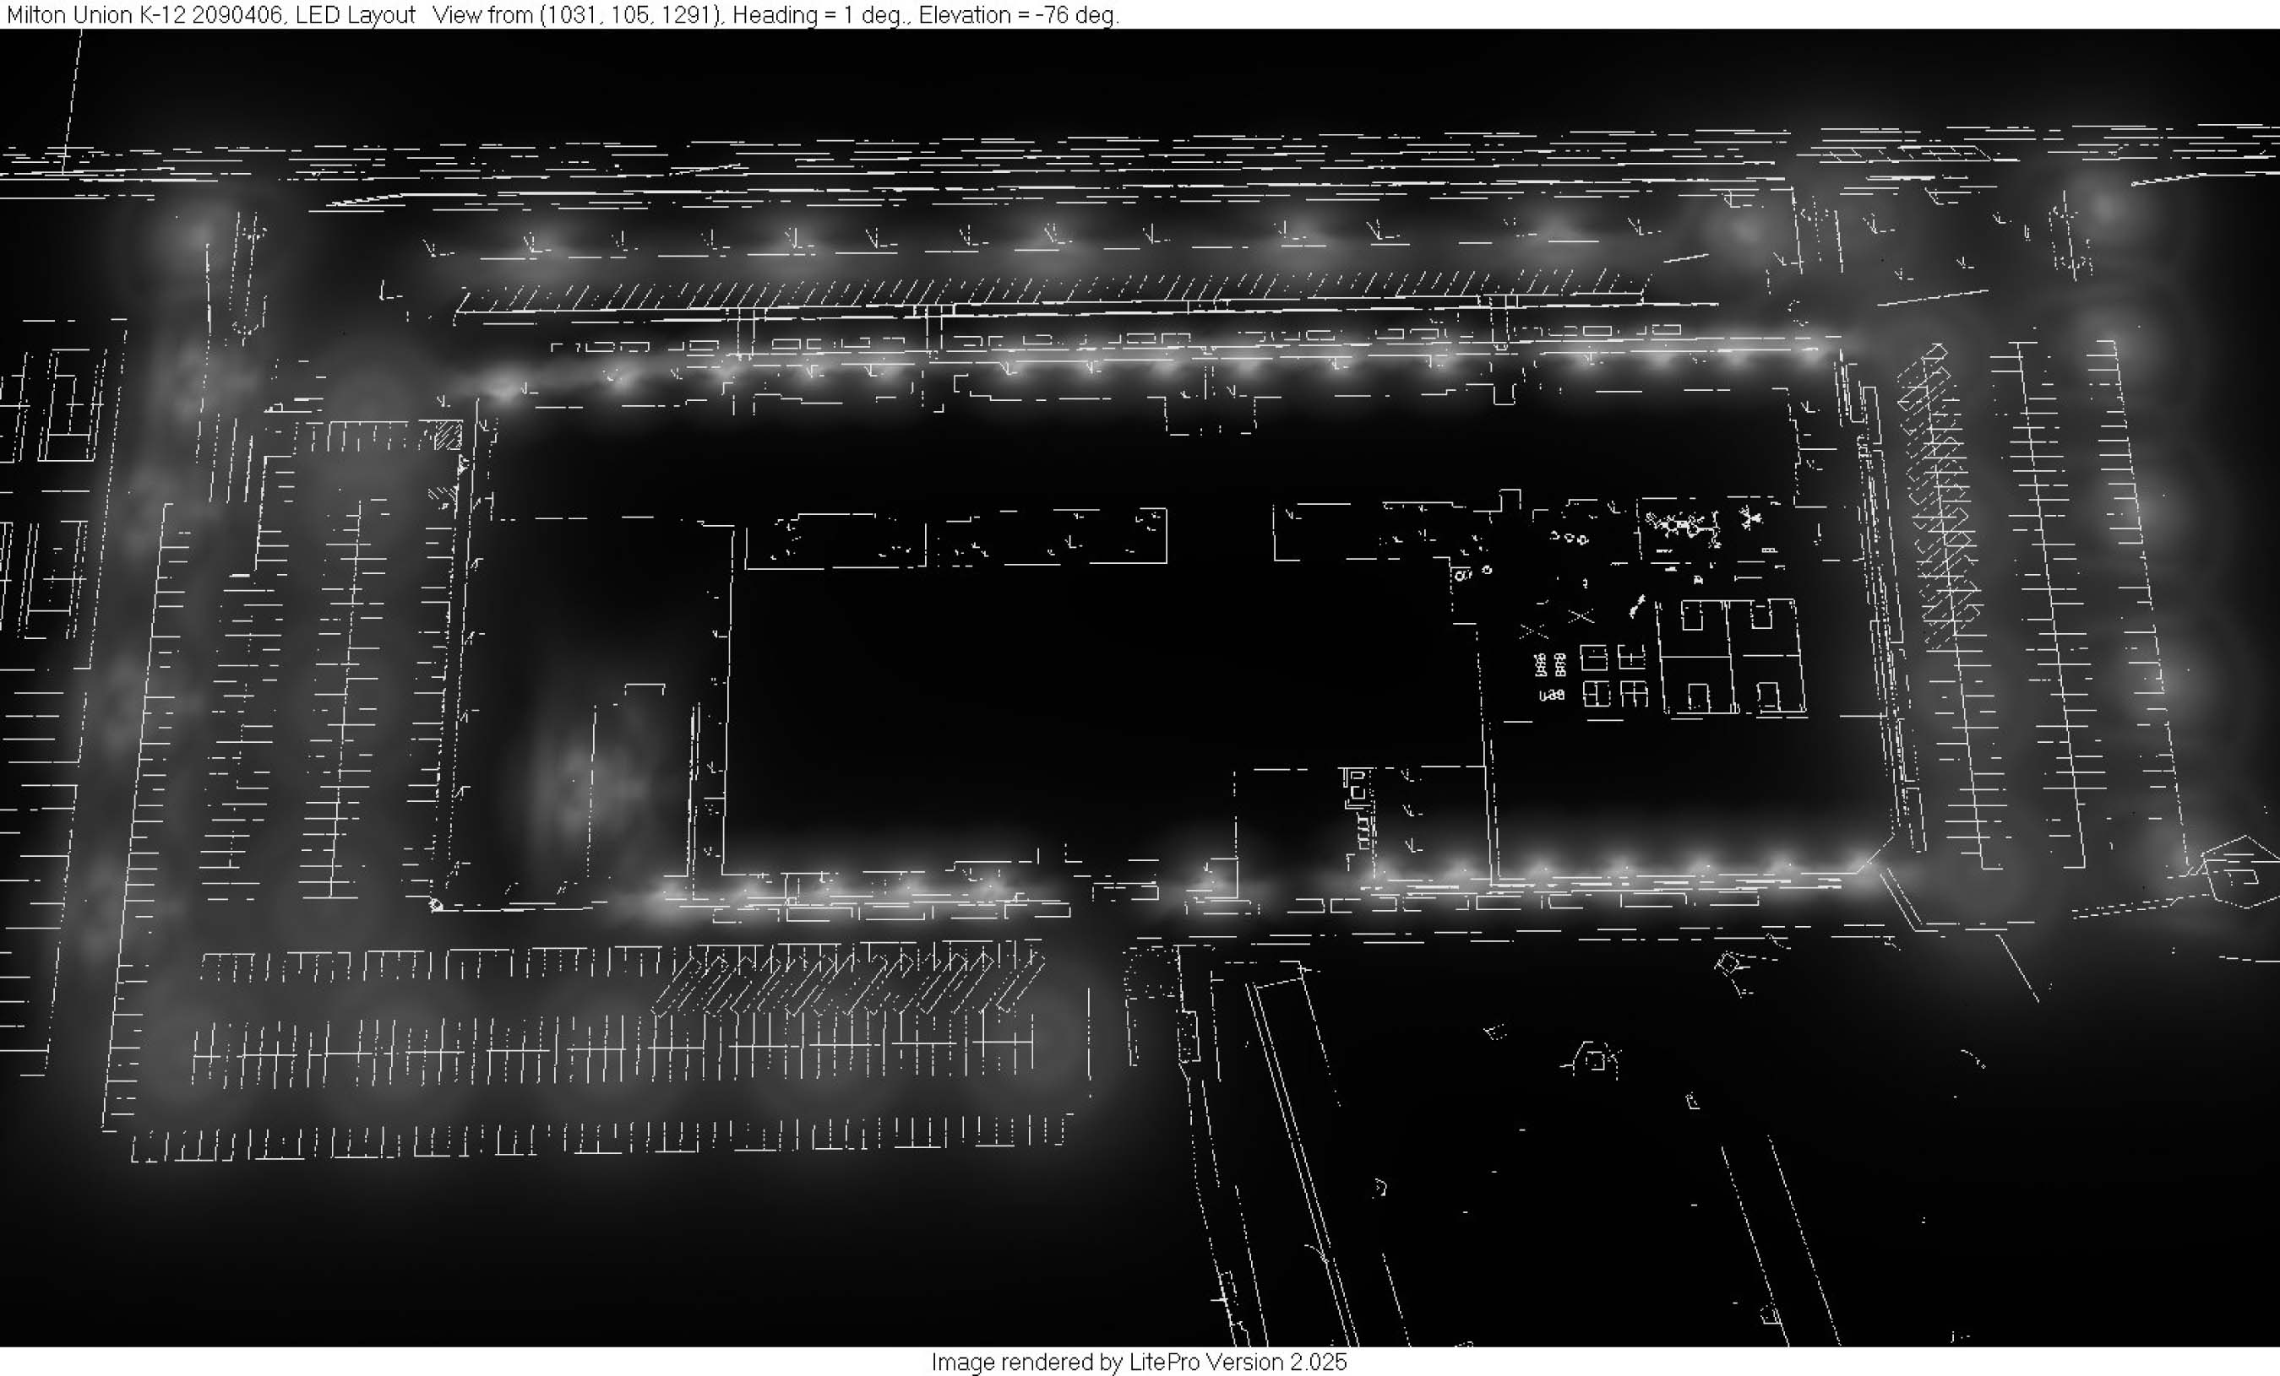
LED Site Lighting

Slide 6
Chiller / Ice Storage
Solar Electric
Size: 34 KW
Cost: $86,400
Payback: 23.5 yrs

Slide 7
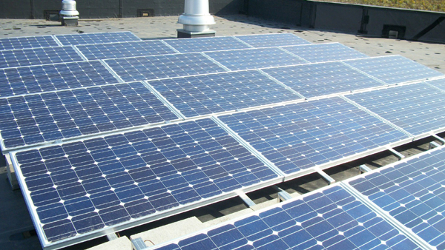
Solar Photovoltaic System
143 Microcrystalline Panels at 240W each
= 34,320 Watt system
Grid-tied utility interactive system

Slide 8
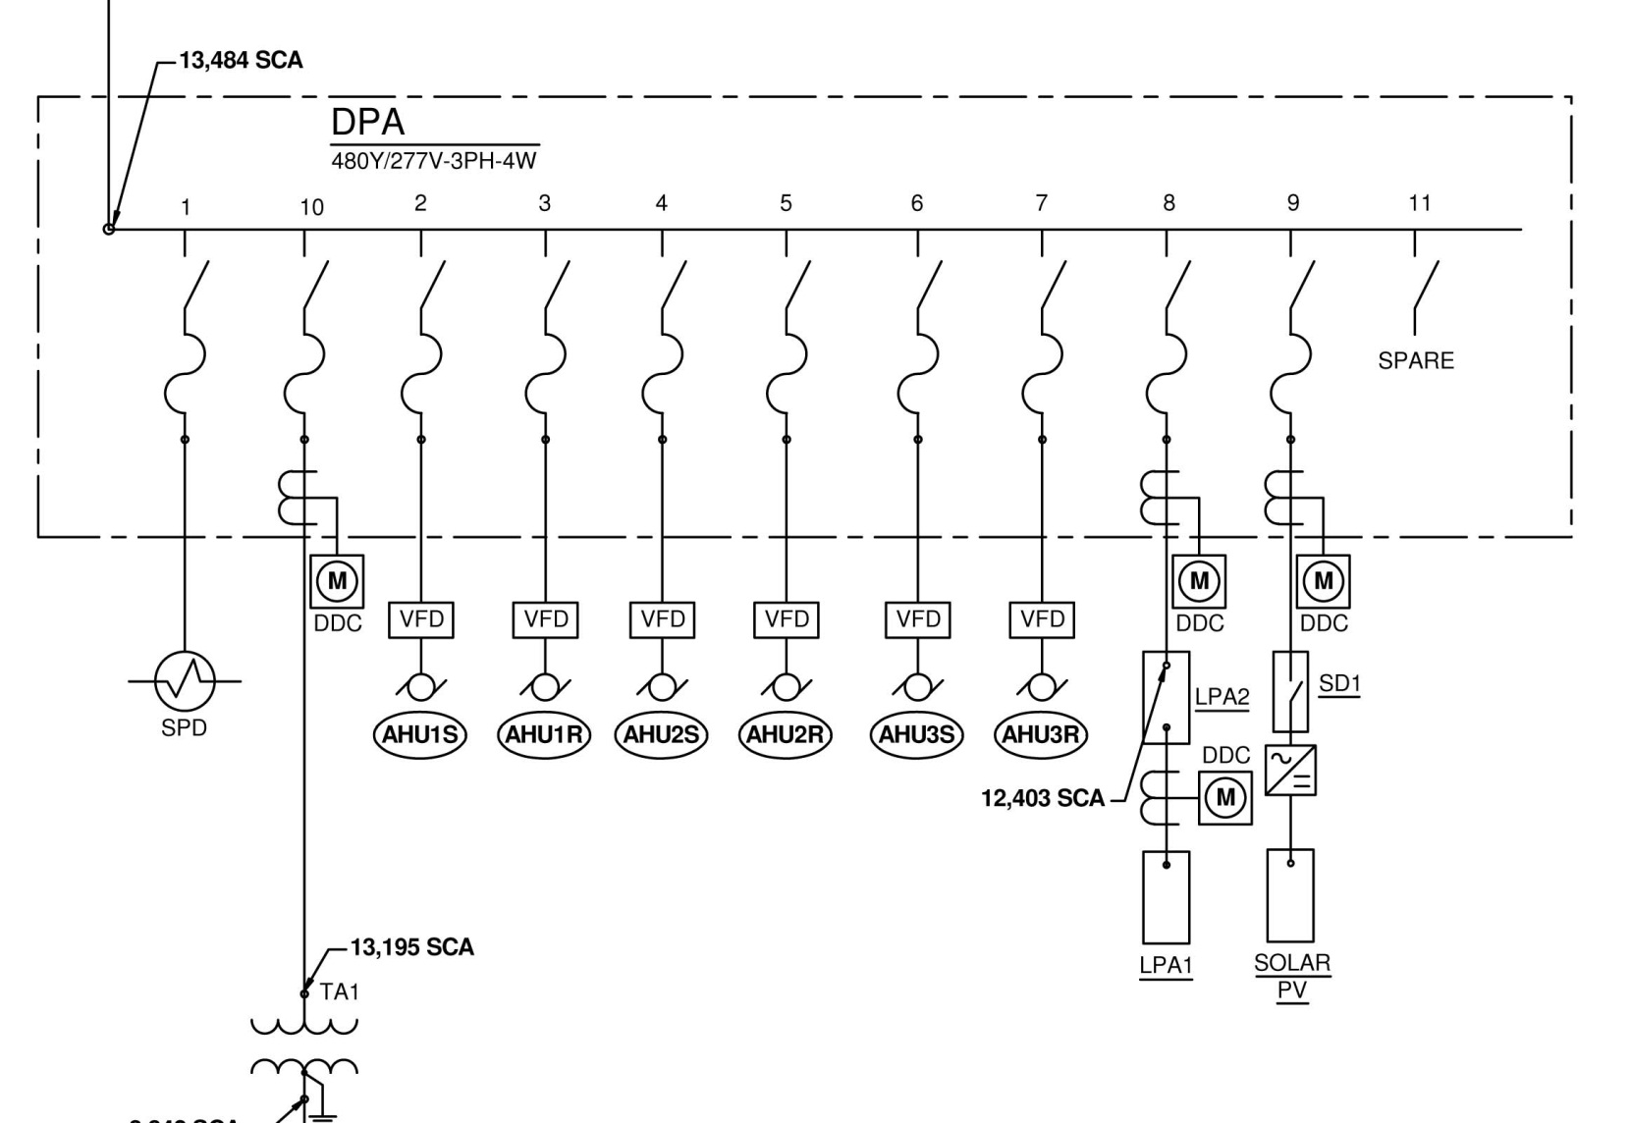
Solar Photovoltaic System

Slide 9
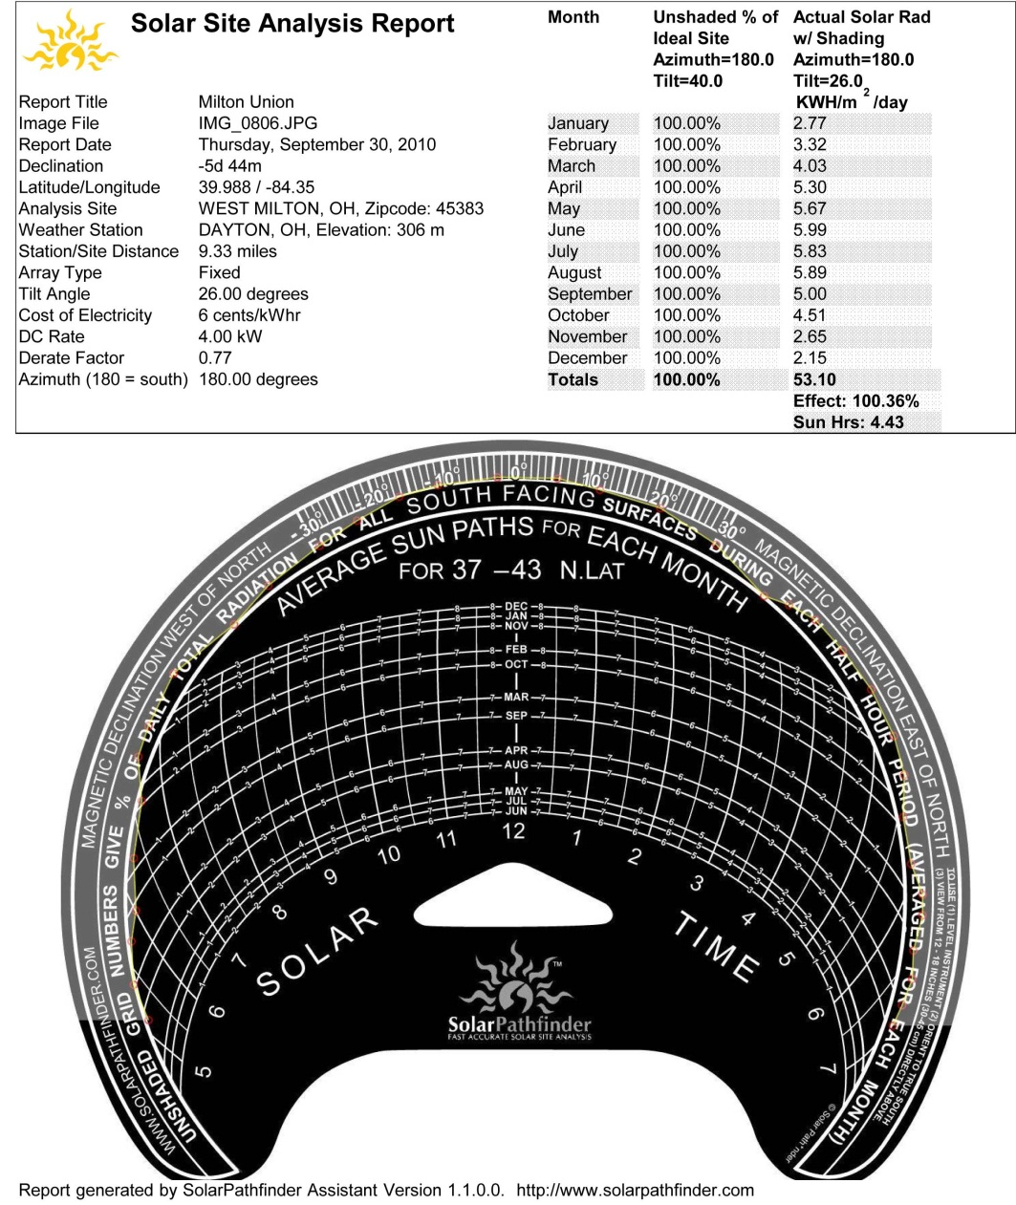
Solar Photovoltaic System

Slide 10
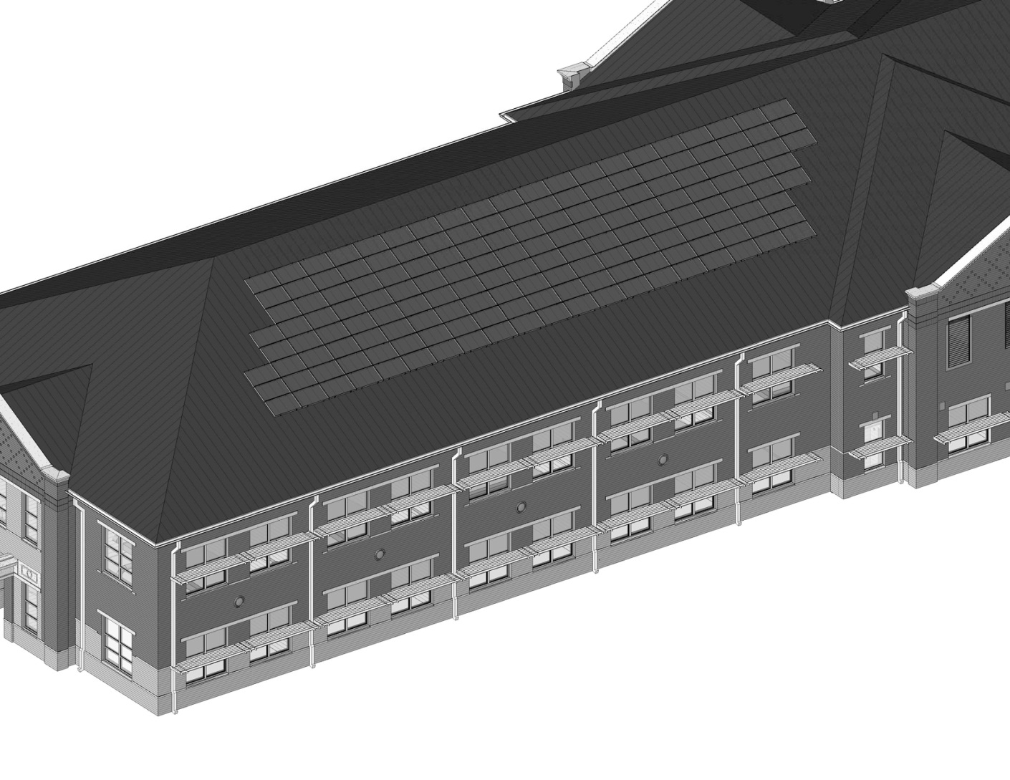
Solar Photovoltaic System

Slide 11
Chiller / Ice Storage
Wind Turbine
Size: 12 KW
Cost: $75,000
Payback: 15.3 yrs

Slide 12
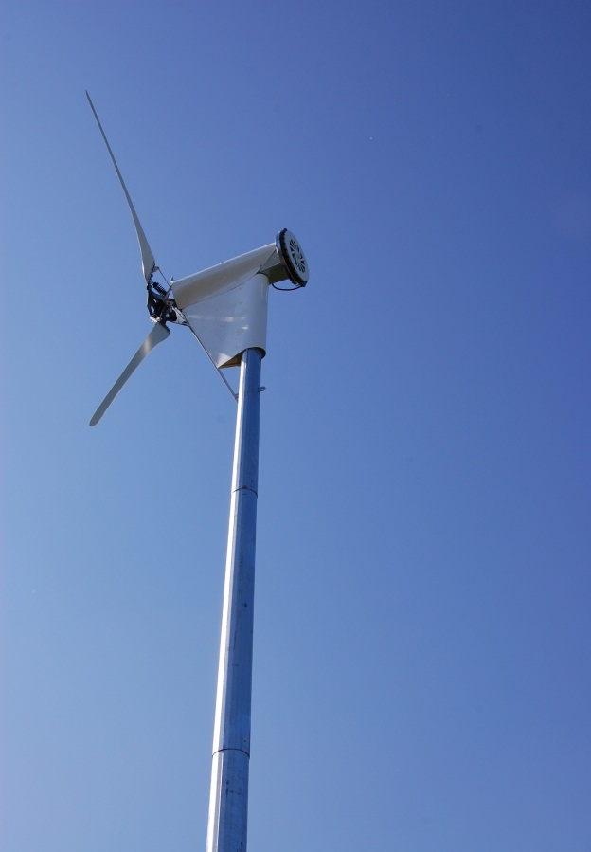
Wind Turbine
12kW wind turbine (mostly for educational purposes)
Turbine output is 480V variable frequency AC, rectified to DC through control panel and inverted with grid-tied utility interactive inverters
Payback was heavily affected by distance away from school

Slide 13
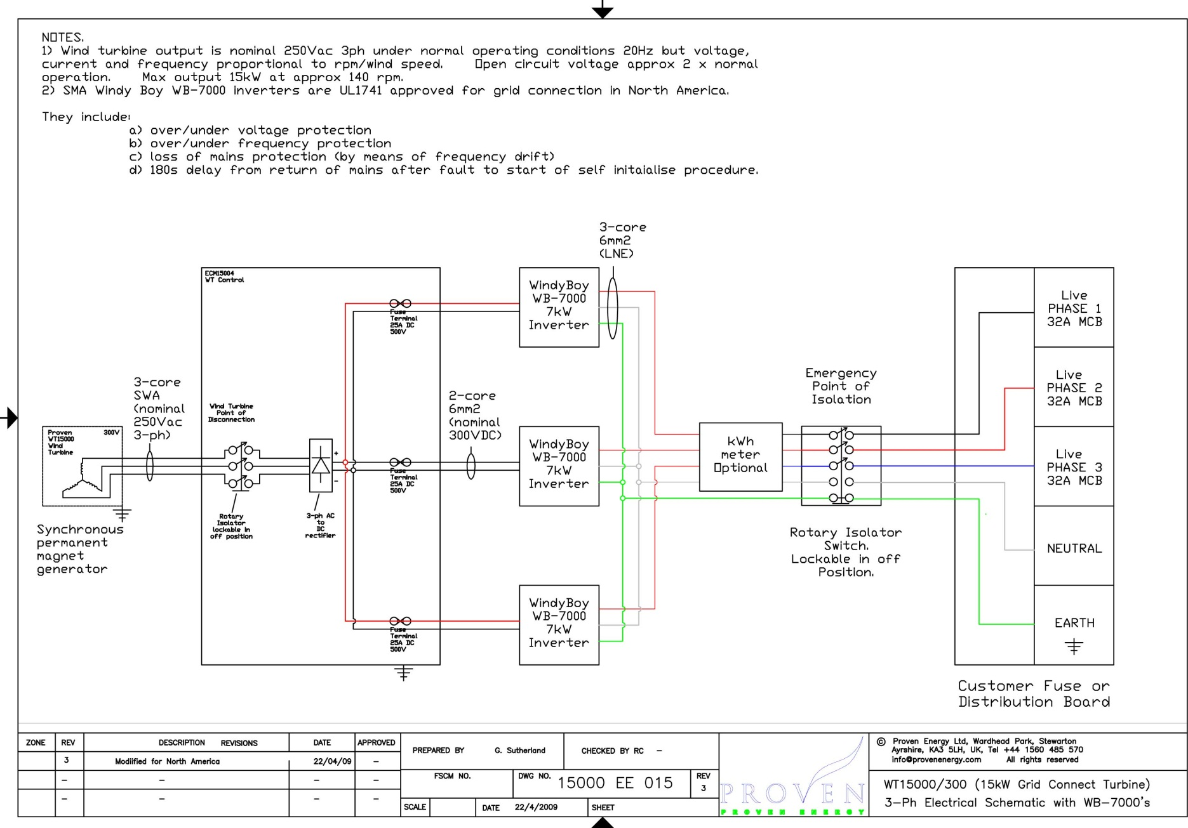
Wind Turbine

Slide 14
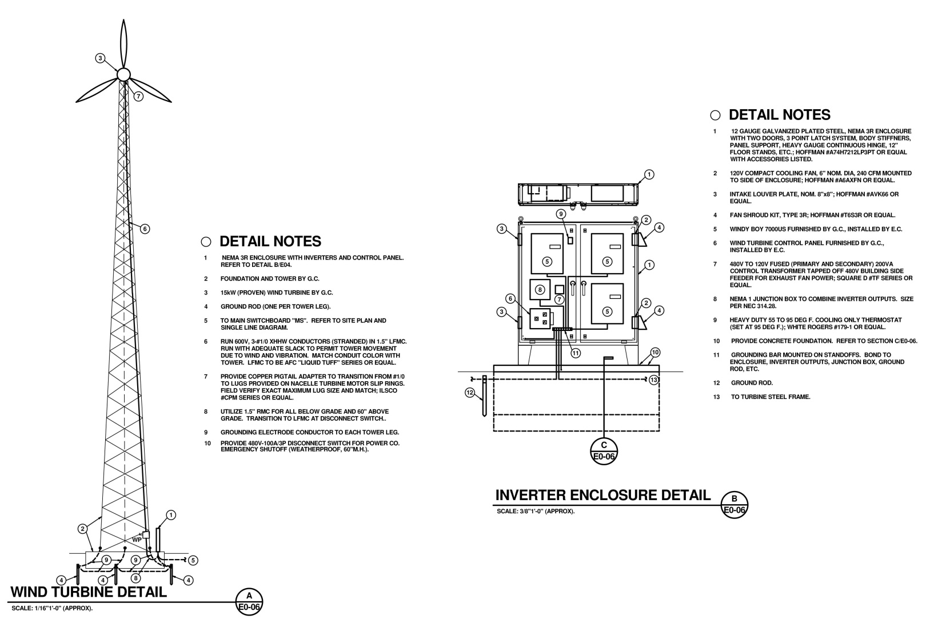
Wind Turbine

Slide 15
Daylight Harvesting
Utilized Trane Trace to model the building without daylight harvesting in the classrooms and alternatives with automatic daylight harvesting as follows:
Alternative 1)
Add 1 row of daylight harvesting in all 2 window classrooms above the base design.
Energy usage went down $2,730/year
Cost: $45,290
16.6 year simple payback

Slide 16
Daylight Harvesting
Alternative 2)
Add 2 rows of daylight harvesting in all 2 window classrooms above the base design.
Energy usage went down $4,735/year
Cost: $98,927
20.9 year simple payback
Alternative 3)
Add 2 rows of daylight harvesting on the south side classrooms only (and 1 row on the North)
Energy usage went down $3,853/year
Cost: $72,000
18.7 year simple payback

Slide 17
Daylight Harvesting
This analysis included increases in gas load due to reduced lighting power.
“Manual” daylight harvesting was selected which includes the outside row of lighting switched separately and the classroom teacher trained to shutoff the lighting when sufficient natural light is available.
This solution added negligible cost to the project , no additional equipment/complicated wiring to maintain and actively involved the staff/students.

Slide 18
Lighting Design Strategies
Investigated changing the ballasts from a 0.88 to a 0.71 BF ballast in the classrooms
Ballast factors dictate how much light is produced, lower the number equals less input watts. We are able to look into this because with the lighting layout required due to ceiling slope, projector locations and room size paired with a standard ballast, the classroom lighting slightly exceeds the OSDM recommended lighting levels.
The problem arose in the fact 0.71BF DIMMING ballasts are not available (thus the daylight harvesting system would have to go away). This was another factor why “manual” daylight harvesting was appealing.

Slide 19
Lighting Design Strategies
Alternative 4)
Change classroom ballasts from 0.88BF to 0.71BF and delete all daylight harvesting (except area "C" corridor).
Energy usage went down $2,900/year
Simple payback: 2.8 year
Project realized 1.137watts/square foot, or 9.4% better than ASHRAE 90.1-2004.

Slide 20
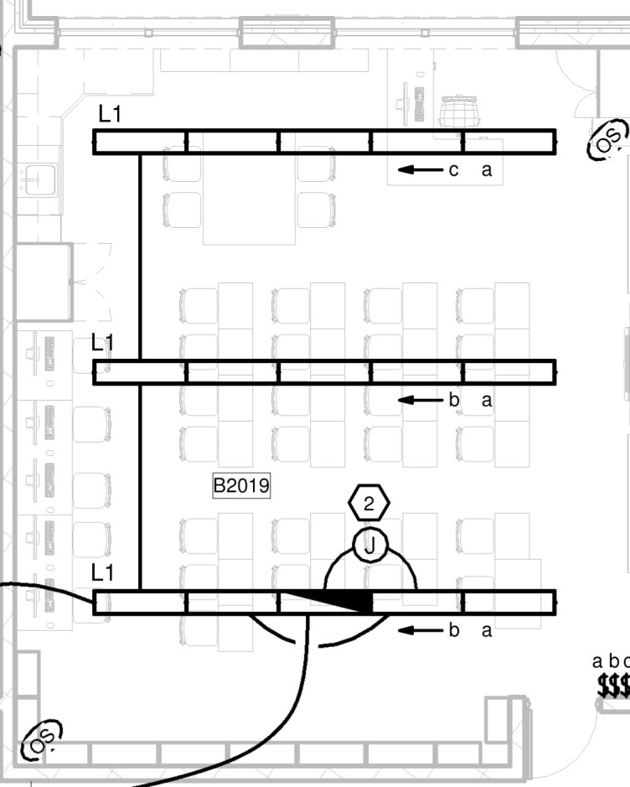
Lighting Design Strategies

Slide 21
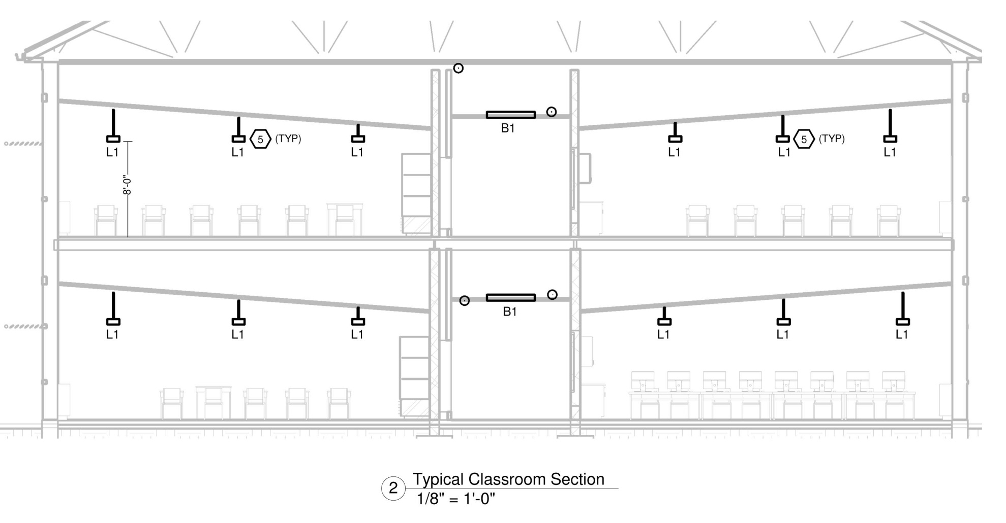
Lighting Design Strategies

Slide 22
Chiller / Ice Storage
Rainwater Harvesting
Size: 75,000 gallons
Cost: $195,000
Payback: 16.2 yrs

Slide 23
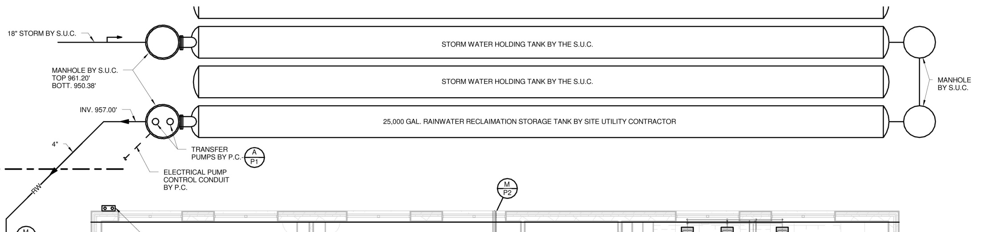
Rainwater Harvesting

Slide 24
Rainwater Harvesting
The plumbing system will have 2.1 million gallons of rainwater go through it each year.
The toilets and urinals are estimated to use 1,445,836 gallons/year which will all end up being served by rainwater.
As for the total water consumption (toilets, urinals, bathroom and classroom lavs, kitchen handwashing sinks, and showers), the total baseline case annual water consumption could total 3,487,780 gallons per year.
The total design case (with the low flow fixtures only, not rainwater harvesting) annual water consumption estimate is 1,977,251 gallons/year.
With the rainwater harvesting (1,445,836 gallons/year), the total potable water savings is 84.8%.

Slide 25
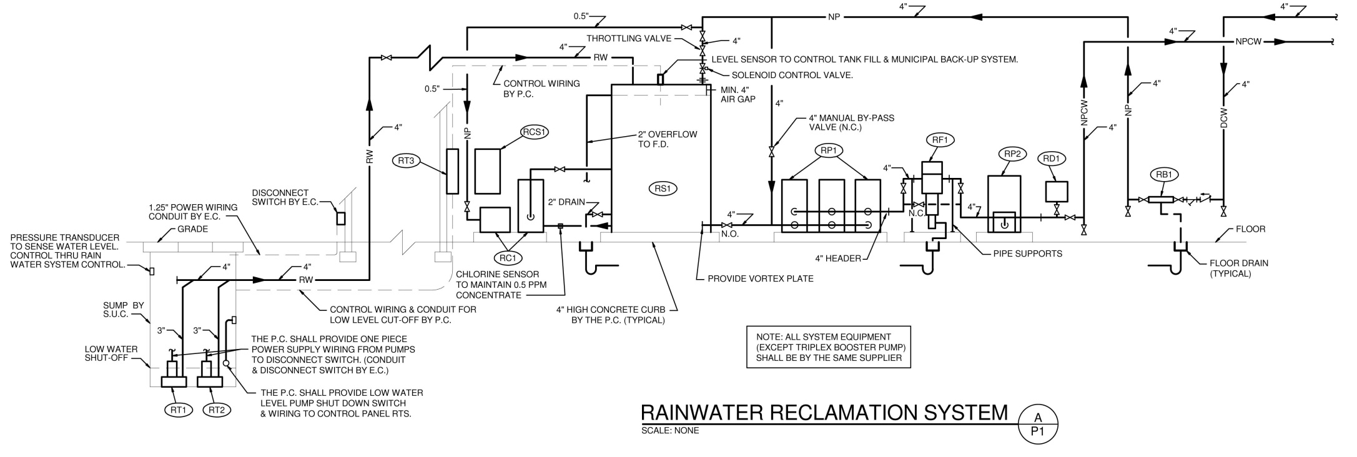
Rainwater Harvesting

Slide 26
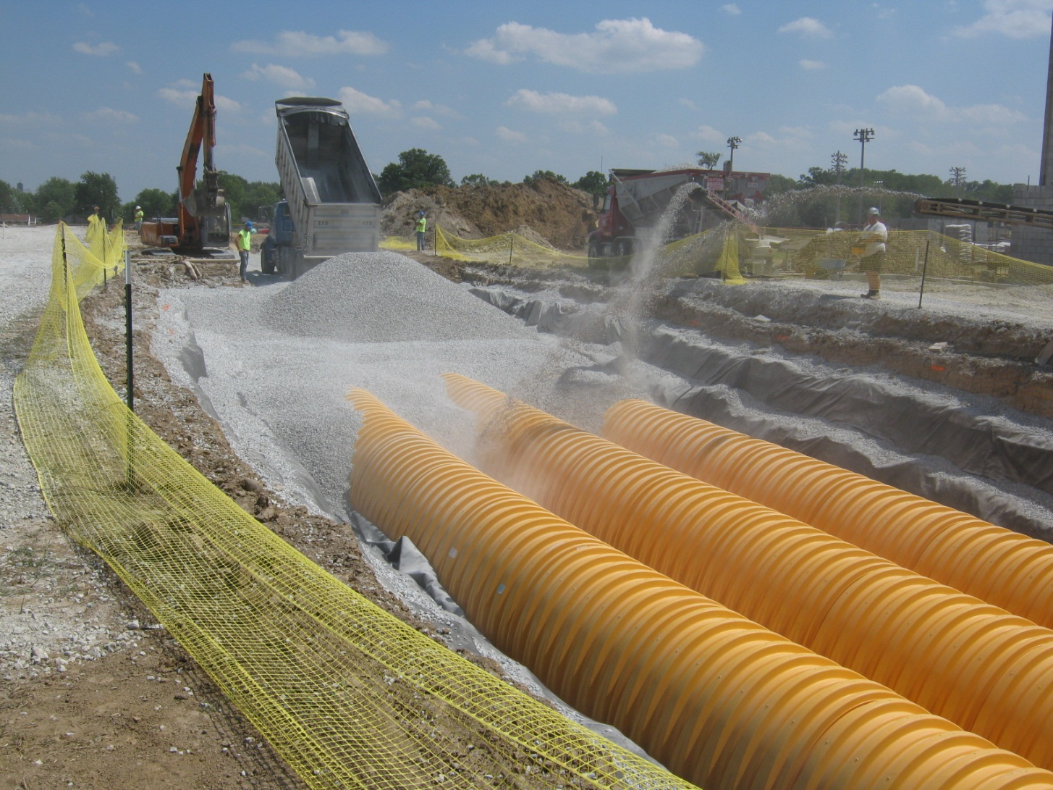
Rainwater Harvesting

Slide 27
Chiller / Ice Storage
Monitoring / Metering
Size: N/A
Cost: $143,000
Payback: 4.79 yrs

Slide 28
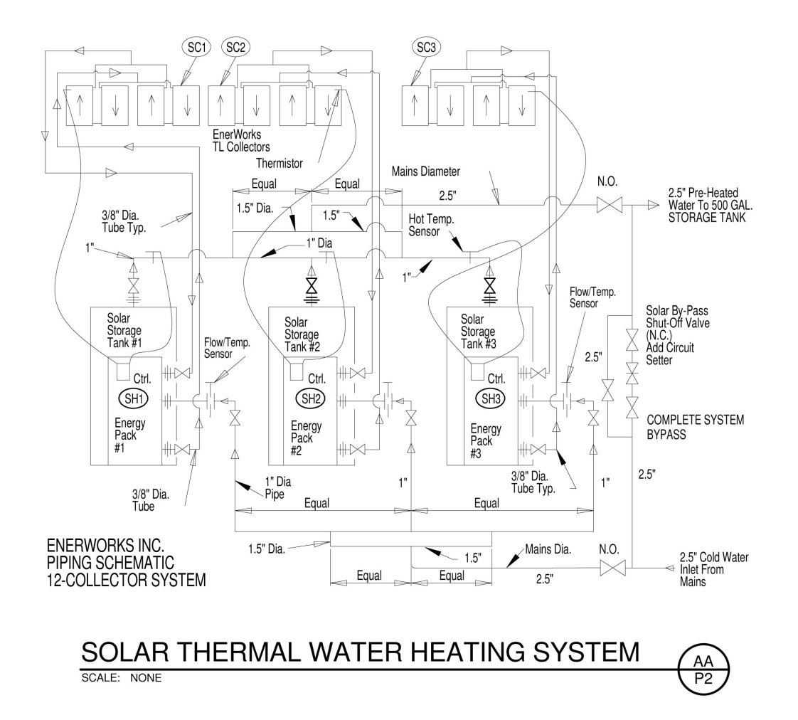
Solar Thermal Domestic Water Heating
12 panels at 2kW each for a total of 24kW (81.9 MBH) of peak DHW heating.
System was modeled by a manufacturer’s representative who estimated approximately 22,226 kWh (75,857 MHB/yr) of heating would be offset per year.
Cost: $22,200
Payback: 3 years

Slide 29
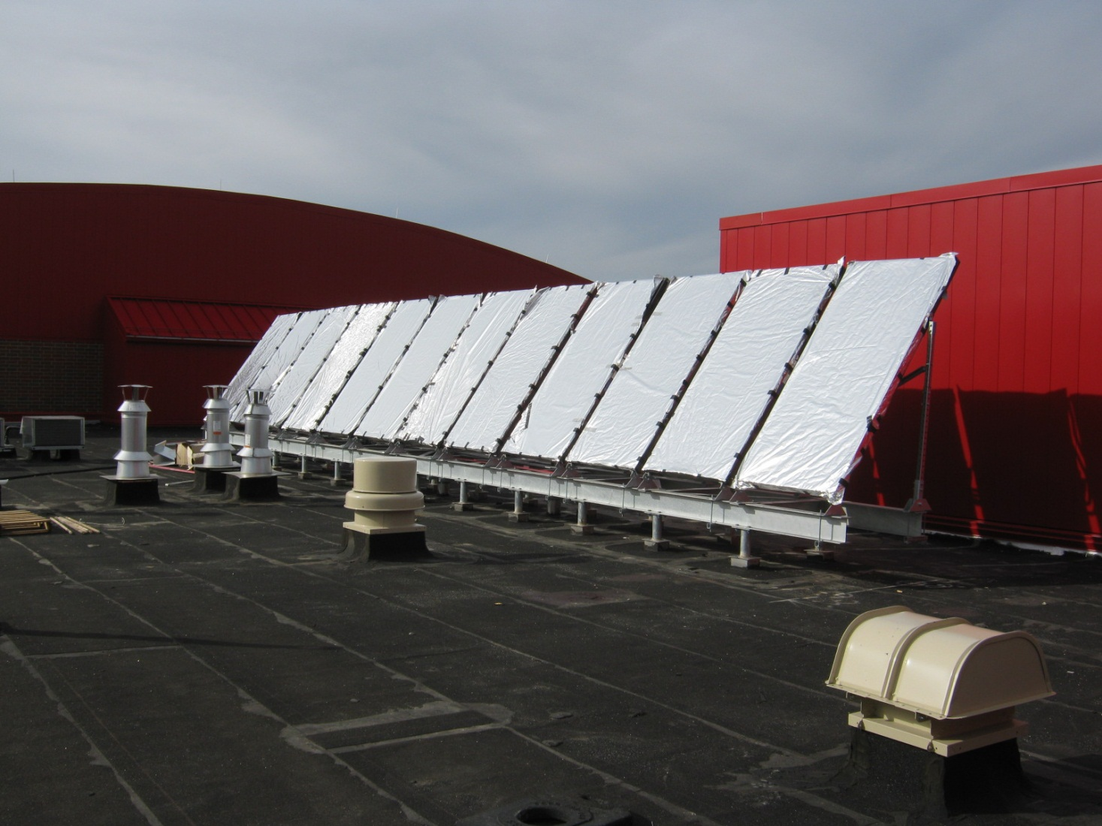
Solar Thermal Domestic Water Heating

Slide 30
System Modeling
System | Energy 10^⁶ BTU/yr | Energy Cost/yr
Baseline System 7 ⁽¹⁾ | 12,011 | $346,454
OSFC LEED Silver Design ⁽²⁾ | 5,674 | $236,924
OSFC Design – Geothermal ⁽³⁾ | 4,370 | $205,201
OSFC Design – Ice ⁽⁴⁾ | 5,957 | $209,637
Proposed Design ⁽⁵⁾ | 5,593 | $191,628
Design meeting the requirements on Standard 90.1-2004 Appendix G
Design meeting the OSFC requirements to achieve LEED Silver, high efficiency chillers, condensing boilers, ERW on AHU minimum outside air
Design meeting the OSFC requirements to achieve LEED Silver, central geothermal chiller-heater system with closed loop geo-exchange field.
Design meeting the OSFC requirements to achieve LEED Silver, high efficiency chillers with ice storage, condensing boilers, ERW on AHU minimum outside air
The proposed design includes the OSFC design - ice and lighting efficiency upgrades, optimized HVAC design, advanced control strategies and M+V program.

Slide 31
Green Initiatives
Strategy | Gas | Elect. | Water | Maint. | Cost | Payback
High Efficiency HVAC Design with Chillers / Ice Storage | $39,200 | $23,290 |  | $7,800 | $165,000 | 2.35 yrs
Lighting Enhancements |  | $8,400 |  |  | $22,400 | 2.67 yrs
Solar Hot Water (400K btu/d) | $7,540 |  |  | -$325 | $22,200 | 3.08 yrs
Metering / Monitoring | $6,200 | $19,300 |  | $4,350 | $143,000 | 4.79 yrs
Wind Turbine (12 KW) |  | $5,500 |  | -$600 | $75,000 | 15.31 yrs
Rainwater Harvesting |  |  | $12,990 | -$1,000 | $195,000 | 16.26 yrs
Solar Electric (34 KW) |  | $3,930 |  | -$250 | $86,400 | 23.48 yrs
 | $52,940 | $60,420 | $12,990 | $9,975 | $709,000 | 5.2 yrs

Slide 32
Green Initiatives
PK-12 - 216,589 sf
Total Annual Savings = $136,325
Total Annual Savings per Sq. Ft. = $ .63
$3.4M Saving over next 25 years in today’s $
$5M over the next 25 years (adjusted for 3% inflation)

